Slide 1
Fuel Monitoring
MCA MAIN PROJECT
Greena J Helan
MCA-A Roll No:55

Slide 2
01
Project Title
02
Relevance of Topic
03
A Description of the project
04
Objectives Of Studies
Contents
05
Existing System and Proposed System
CONTENTS
06
06
Input/ Output and Modules.
07
Algorithm to be used
08
Data Set

Slide 3

Project Title:
FUEL MONITORING

Slide 4
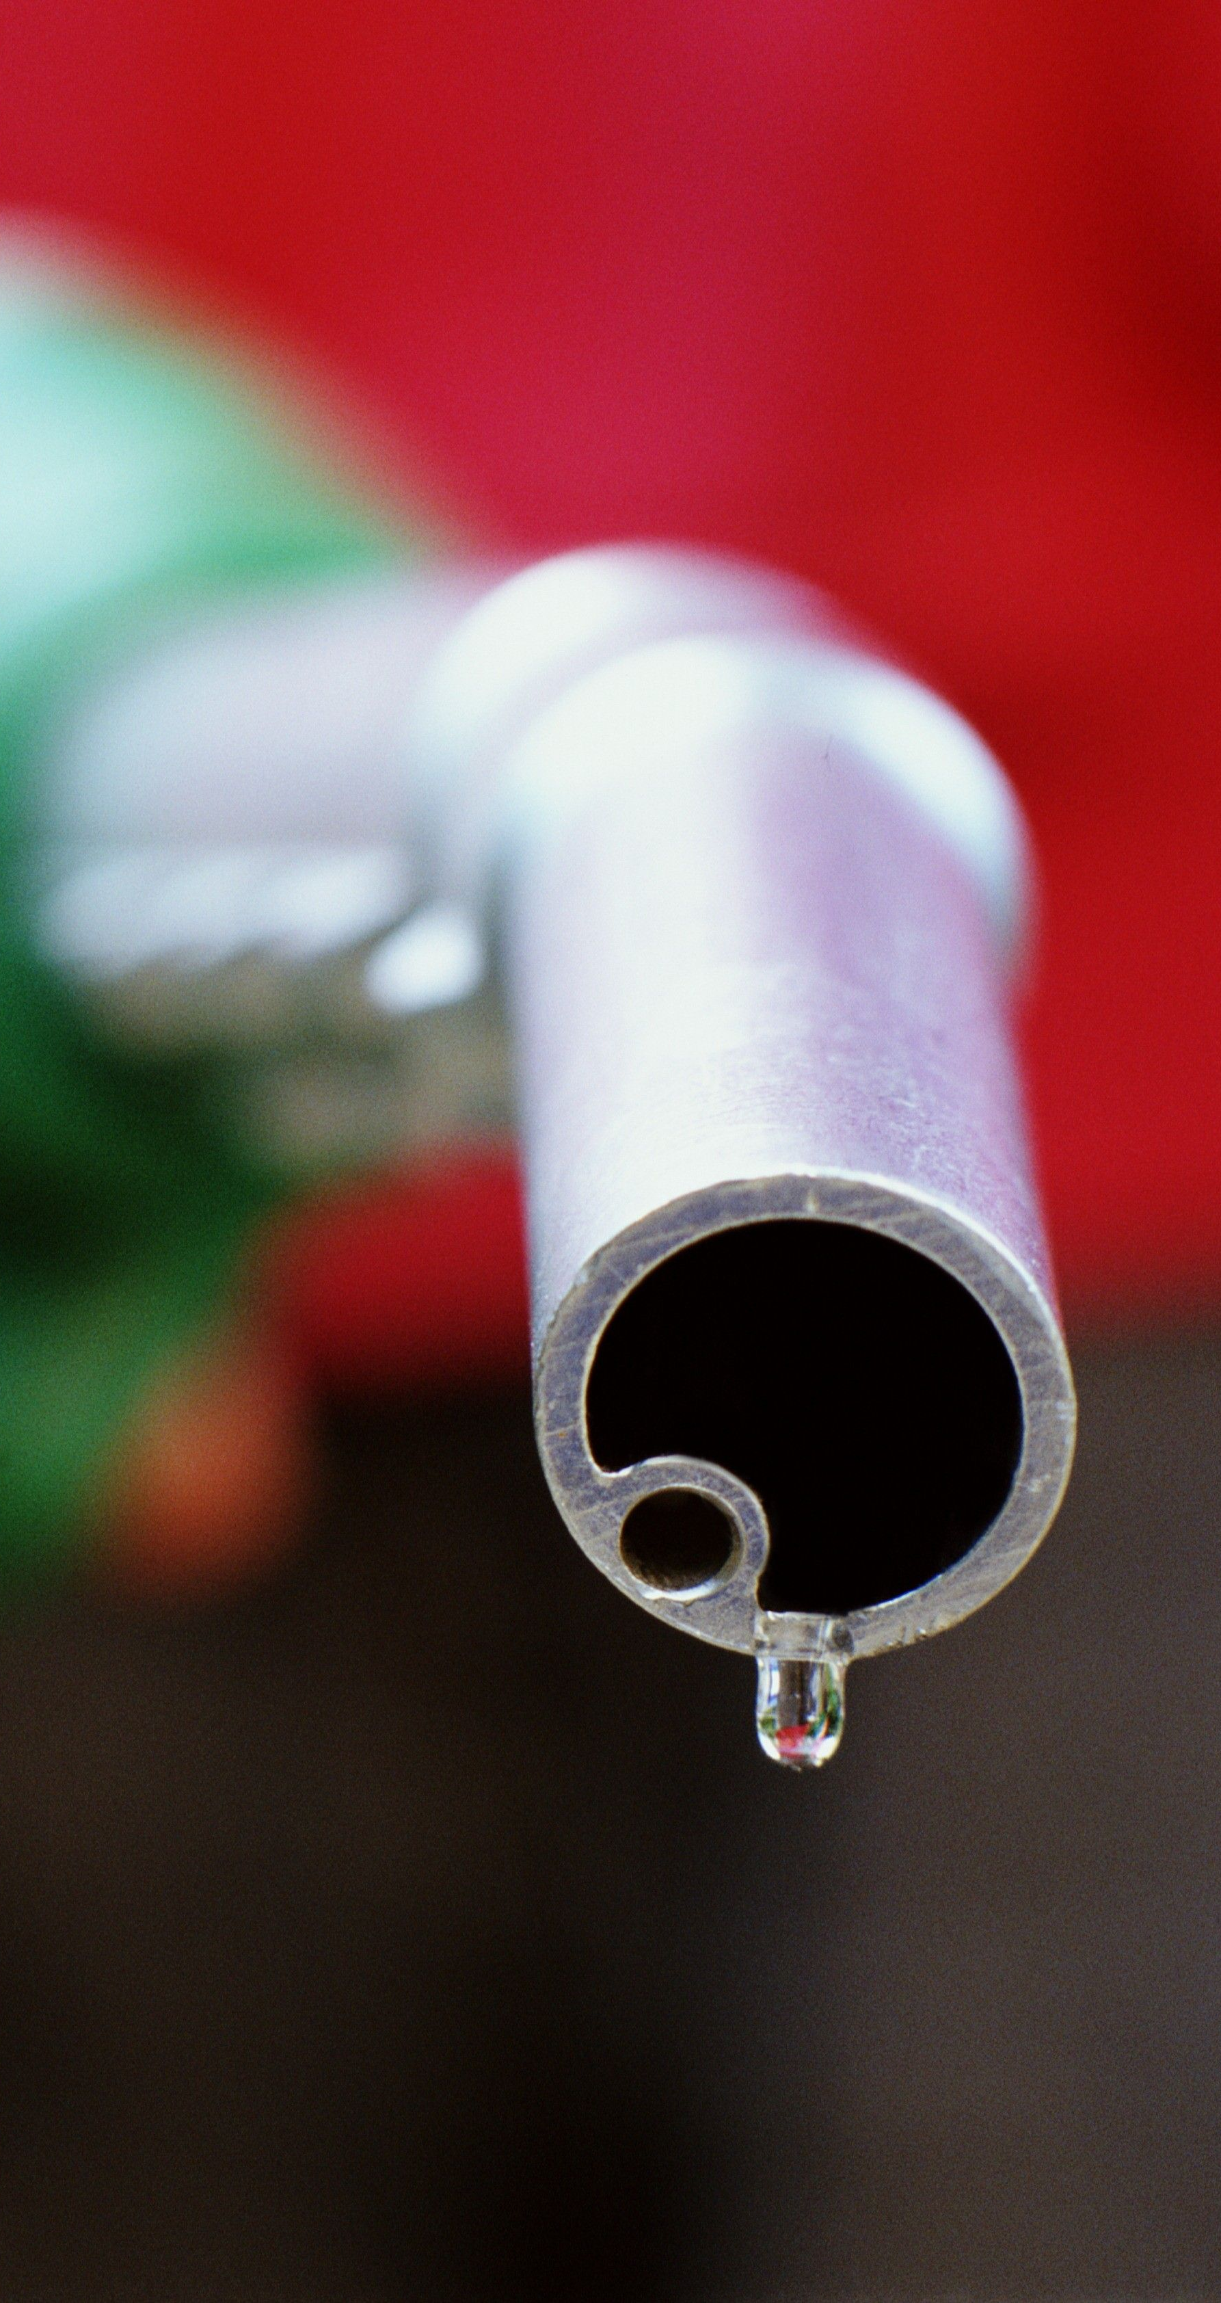

Relevance Of Topic
Fuel consumption will help to calculate millege of the vehicle based on the vehicle used.
Check the amount of co2 in a vehicle to avoid accidents and pollution.
By predicting the Fuel price early we can buy the stock products by this Pumb owners will get profit.
There for customers can know stock price ,so that pumb Authorites don’t take any Advantage.

Slide 5
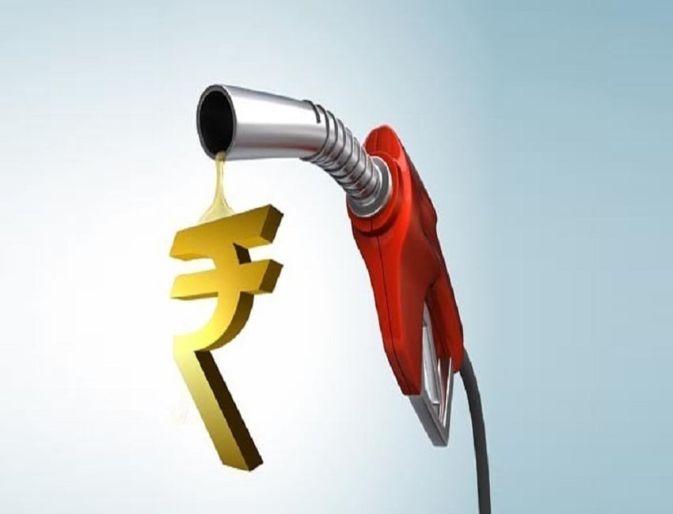
Project Description
The Main Aim of the project is to predict fuel price prediction using ML and predict the amount of fuel consumed by a vehicle in a particular distance in city , Highways and the amount of CO₂ generated in vehicle .
To predict the amount of fuel consumed by a vehicle and the CO₂ generated by the vehicle depends on several internal factors such as model year, fuel type, cylinders, carmaker, class type and transmission type.
We are using multiple regression machine learning algorithm to build a model.

Slide 6
Objective Of The Project
The aim of Fuel Monitering is to predict price of Fuel which help to know the upcoming days fuel price to an extend.
The know amount fuel consumed to move our vehicle in a particular distance and the amount CO₂ generated from our vehicle. Which helps to reduce the pollution.

Slide 7
Existing system
Fuel price is known in News paper
Milage of a vehicle testing using manually by particular amount of fuel taken and drive the vehicle up to finish it.
CO₂ is testing in smoke testing centre.
Proposed system
Predict Fuel price in Earlist
predict the Fuel Consumption of vehicle in city and Highway using Multiple Linear Regression
predict the amount of CO₂ generated in our vehicle using Machine Learning Algorithm.
Fuel price and Fuel consumption can predict in one application

Slide 8
Modules &input/output

Slide 9
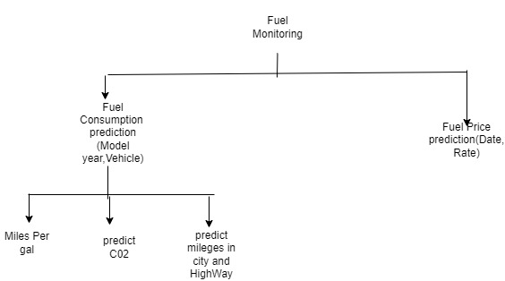
Modules
1.Data preprocessing
2.Dataset splitting
3.Modeling
4.Training
5.Testing
6. Prediction

Slide 10

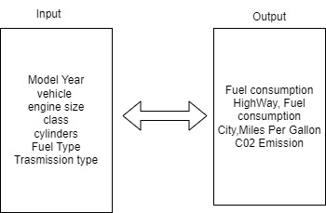
Input/Output

Slide 11
Algorithm Used:
Multiple Linear Regression
Multiple linear regression (MLR), also known simply as multiple regression, is a statistical technique that uses several explanatory variables to predict the outcome of a response variable. Multiple regression is an extension of linear (OLS) regression that uses just one explanatory variable

Slide 12
Dataset

Slide 13
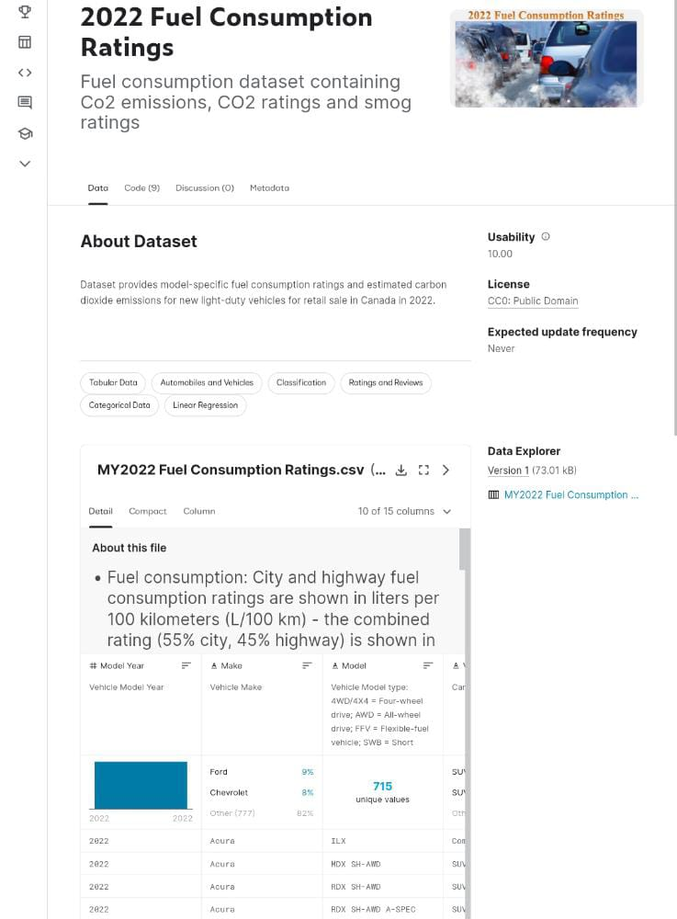
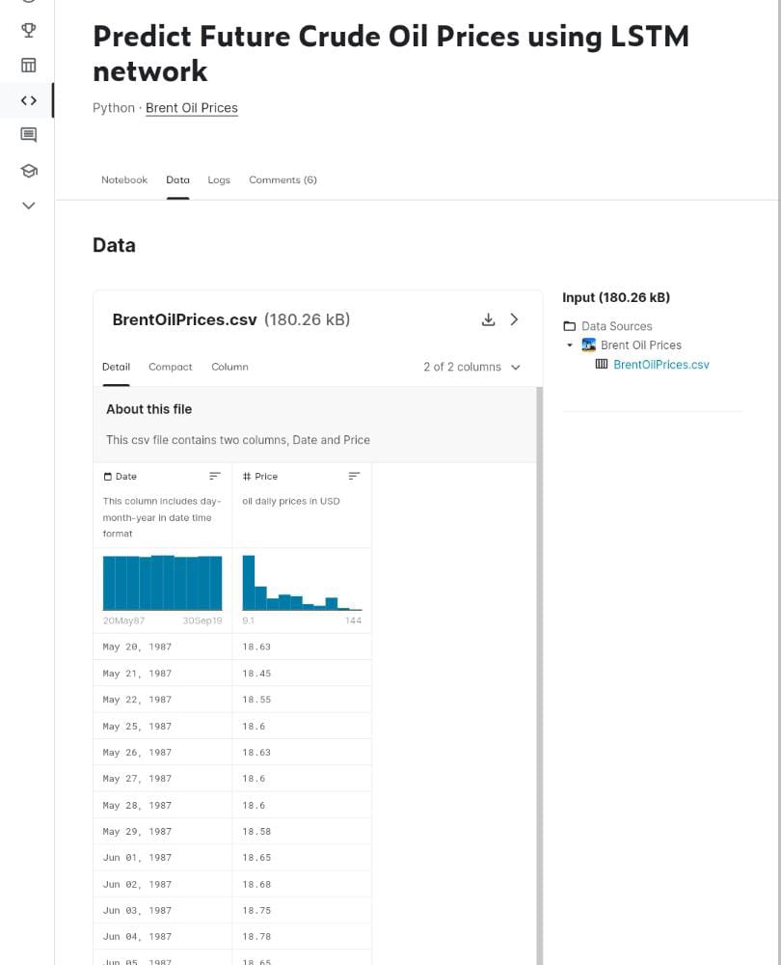
Fuel consuming Ratings
Dataset provides model-specific fuel consumption ratings and estimated carbon dioxide emissions for new light-duty vehicles for retail sale in Canada in 2022.
Fuel price Prediction
Dataset provides model-specific fuel price ratings

Slide 14
THANK YOU….

